Slide 1


K. RAMAKRISHNAN COLLEGE OF ENGINEERING
(AUTONOMOUS), SAMAYAPURAM - TRICHY
DEPARTMENT OF ARTIFICIAL INTELLIGENCE
AND DATA SCIENCE
ADI1221– PRINCIPLES OF ARTIFICIAL INTELLIGENCE
Loan/Credit Eligibility Reasoning Engine Using FQL-Based Rule Inference on Live Application Data
PRESENTED BY
SUPERVISOR
NITHYASR R PRADEEPA D YAZHINI G
Mrs.R.KIRTHIGA
IBM TRAINER
Ms.VIGNESHWARI
9/6/2025

Slide 2
PRESENTATION OVERVIEW
1. Problem Statement
2. Objectives
3. Literature Survey
4. AI technique selection with justification 5. System Architecture
6. Dataset and API identification
7. Project Planning
8. Closing Statement
9/6/2025

Slide 3
PROJECT INTRODUCTION
Loan/Credit Eligibility Reasoning Engine Using FQL-Based Rule Inference on Live
Application Data is an intelligent decision-support system designed to evaluate an applicant’s eligibility and financial risk for loans or credit. Traditional systems mainly depend on fixed
rules and current financial information such as income, credit score, existing loans, and expenses.
The proposed system uses FQL (Fuzzy Query Language) based rule inference to analyze live application data and provide a more flexible and explainable assessment. It considers multiple financial factors and classifies the applicant into Low, Medium, or High Risk categories.

Slide 4
PROBLEM STATEMENT
Background
Traditional loan approval systems rely on manual verification or fixed rule-based methods, making decisions slow, inconsistent, and prone to human errors.
Current Challenges
High processing time
Manual document verification
Inconsistent decision-making
Fraudulent applications
Limited explainability
Increasing loan defaults
Need
Develop an AI-powered reasoning engine that evaluates live applicant data using FQL rules.
9/6/2025

Slide 5
OBJECTIVES
To study the existing FQL-based loan eligibility concepts as a reference.
To understand how Fuzzy Logic and IF–THEN rules are used in credit assessment.
To refer existing methods for analyzing income, credit score, debt, and loan amount.
To use Low, Medium, and High fuzzy conditions for handling uncertain data.
To develop a loan eligibility reasoning system based on the studied reference concepts.
To integrate live application data through APIs for real-time evaluation.
To improve the existing approach by providing flexible and explainable eligibility decisions.

Slide 6
LITERATURE SURVEY
  Uses fixed rules for loan eligibility.
  Mainly analyzes current financial data.
  Checks income, credit score, existing loans, and expenses.
  Provides a simple Eligible / Not Eligible result.
  Focuses mainly on the applicant’s present repayment capacity.
  Has limited consideration of future financial changes.
  Handles uncertain financial conditions poorly.
  May require manual verification for borderline applications.
  Provides limited explanation for complex decisions.
EXISTING SYSTEM
9/6/2025

Slide 7
PROPOSED SYSTEM
  Uses FQL (Fuzzy Query Language) based rule inference.
  Processes live application data.
  Analyzes income, expenses, EMI, credit score, debt, and employment stability.
  Provides Low, Medium, or High Risk classification.
  Evaluates current financial stability.
  Estimates future financial stability using possible income changes.
  Handles uncertain and varying financial conditions.
  Provides explainable rule-based decisions.
  Reduces dependency on manual assessment.
  Supports more flexible and data-driven loan/credit eligibility assessment.

Slide 8

AI TECHNIQUE SELECTION
& JUSTIFICATION
FQL is used to query and reason over fuzzy applicant data using rules, allowing the system to make flexible loan eligibility decisions instead of using only strict Yes/No conditions.
Example :
FQL in Loan Eligibility
Applicant Details:
Income = ₹40,000 → Medium/High Credit Score = 720 → Good
Debt = ₹8,000 → Low
9/6/2025

Slide 9
Why FQL is Used?
Handles uncertain data in loan applications.
Uses Low, Medium, High type fuzzy values.
Evaluates income, credit score, debt, etc.
Supports rule-based decision making.
Gives flexible eligibility decisions instead of only Yes/No.
Helps improve the reasoning and accuracy of the loan eligibility system.

Slide 10
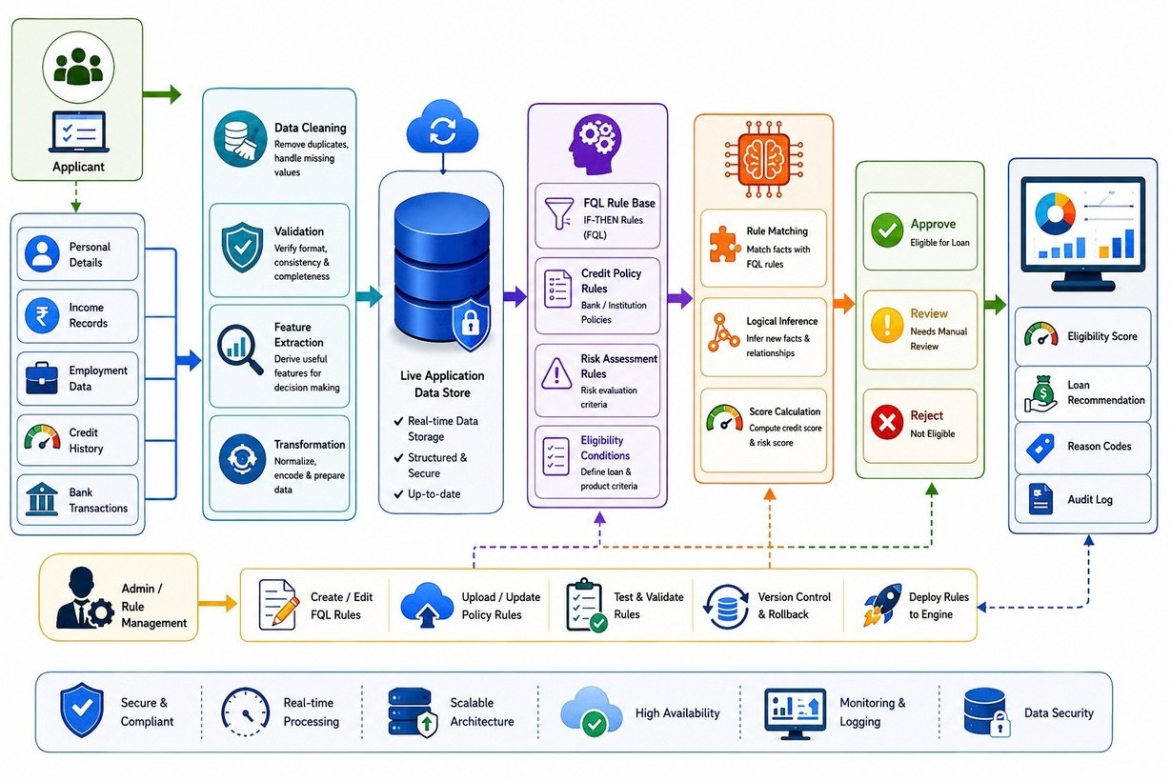
SYSTEM ARCHITECTURE
9/6/2025

Slide 11
DATASET & API IDENTIFICATION
Required Features
Dataset
:
Loan/Credit application dataset is used.
Contains applicant details such as income, age, credit score, loan amount, employment status, debt, and repayment history.
Used to create and test FQL-based eligibility rules.
Dataset can be obtained from Kaggle or other public financial datasets.
API
:
A Loan Application API provides live applicant data.
API sends income, credit score, loan amount, and debt to the reasoning engine. FQL rules process the received data.
The system returns the final loan eligibility status and reasoning.
9/6/2025

Slide 12
MODULES USED
1. User/Application Data Module
Collects applicant details such as income, age, employment, expenses, and
loan requirements.
2. Financial Data Analysis Module
Analyzes income, existing EMI, expenses, debt level, and
repayment capacity.
3. Credit Score Evaluation Module
Evaluates the applicant’s credit score and credit history.
4. FQL Rule Inference Module
Applies FQL-based rules to analyze the collected financial data and generate
eligibility results.
9/6/2025

Slide 13
5. Risk Assessment Module
Classifies the applicant into Low, Medium, or High Risk categories.
6. Future Stability Prediction Module
Evaluates possible future income changes and estimates future repayment stability.
7. Eligibility Decision Module
Generates the final Eligible, Not Eligible, or Further Review decision based on the
rule results.
8. Dashboard & Report Module
Displays applicant information, risk level, eligibility result, and reasoning in a
Simple dashboard.

Slide 14
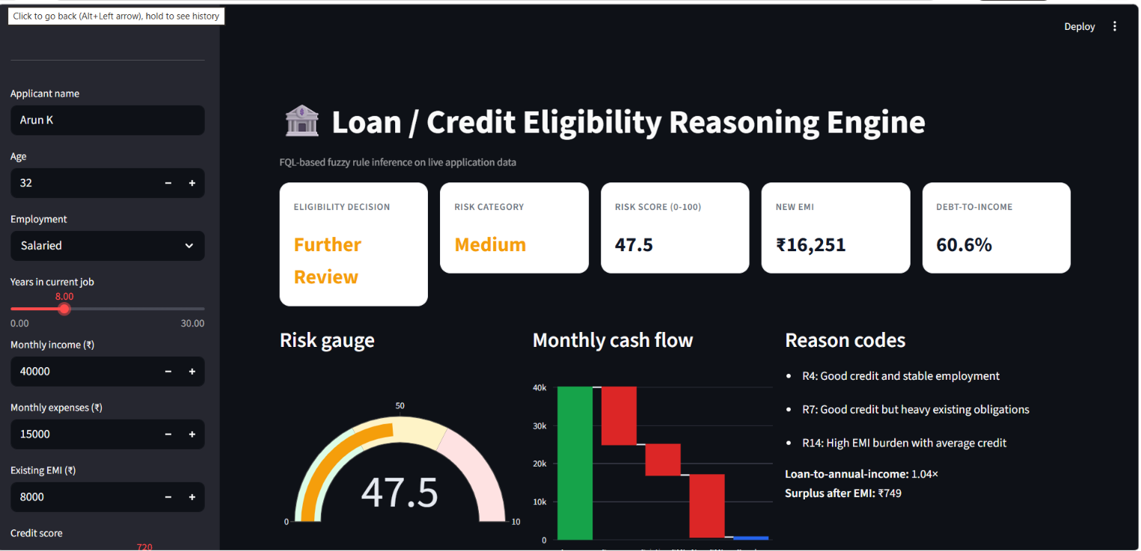
OUTPUT SCREENSHOTS

Slide 15
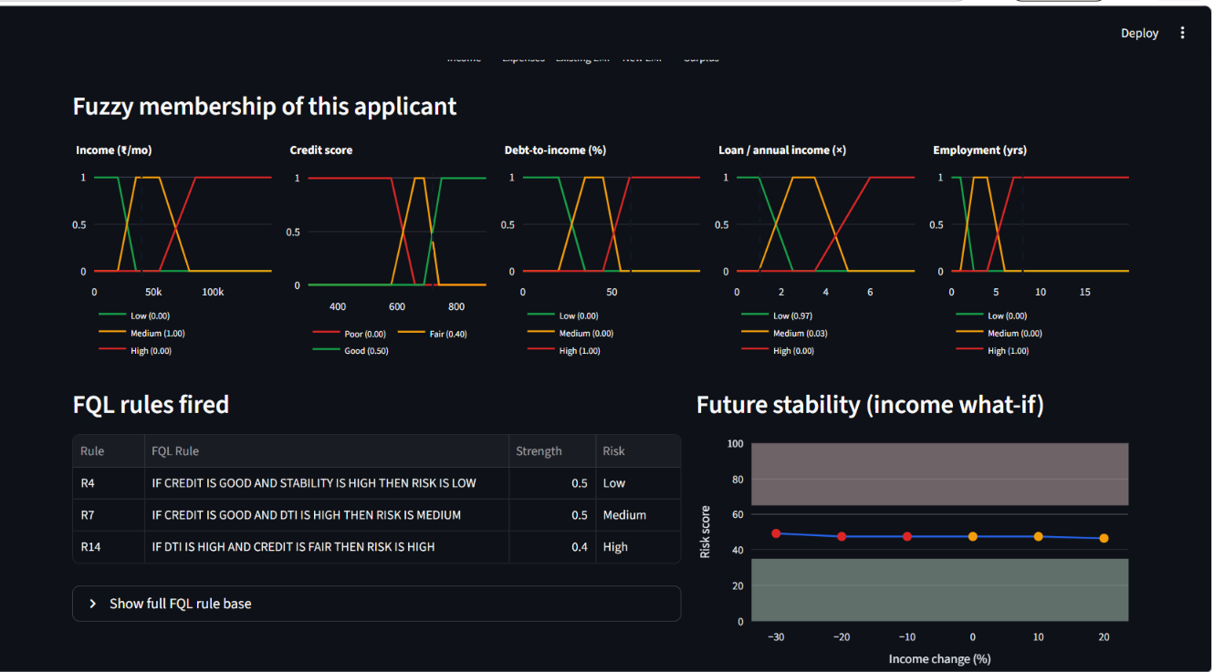

Slide 16
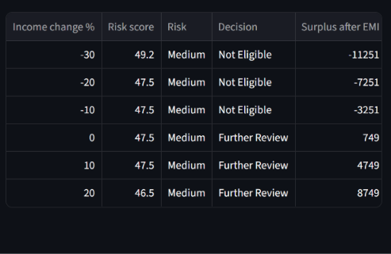


Slide 17
CONCLUSION
The Loan/Credit Eligibility Reasoning Engine Using FQL-Based Rule Inference on Live Application Data provides an intelligent and flexible approach for evaluating loan eligibility. The system analyzes important financial factors such as income, credit score, expenses, existing EMI, and debt level using FQL-based rules. It also considers future financial stability under possible changes in income and repayment capacity. The system provides Low, Medium, or High Risk classification along with an explainable eligibility decision. Overall, the proposed system helps improve accuracy, transparency, and flexibility in loan and credit assessment.

Slide 18

9/6/2025

